Slide 1
SALON & SPA

Slide 2
SALON & SPA

Slide 3
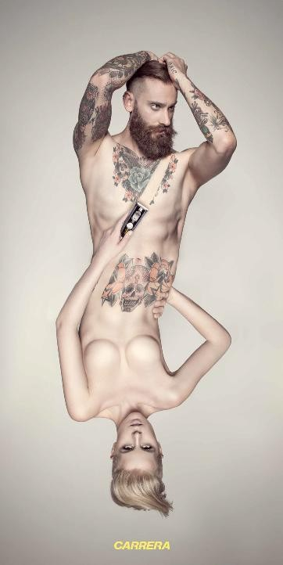
CARRERA
Trend setter for Technology and
Lifestyle now extends it's licensing vertical to India for "Carrera Salon
& Spa."

Slide 5
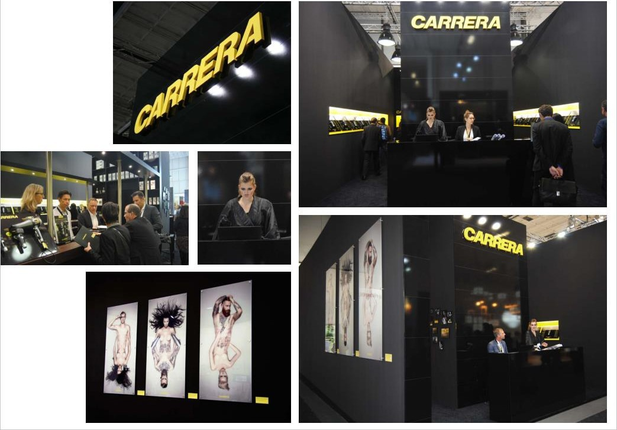
HAIR
SKIN
FACE NAILS
Offerings
Our menu is impeccably curated to suit to many. Concern based, Product based, Performance based are few parameters we have considered.
Our menu focuses on gentlemen's, kids and ladies categories with due focus on delighful experience with customized packages.
BRIDAL SERVICES
BESPOKE LUXURY

Slide 6
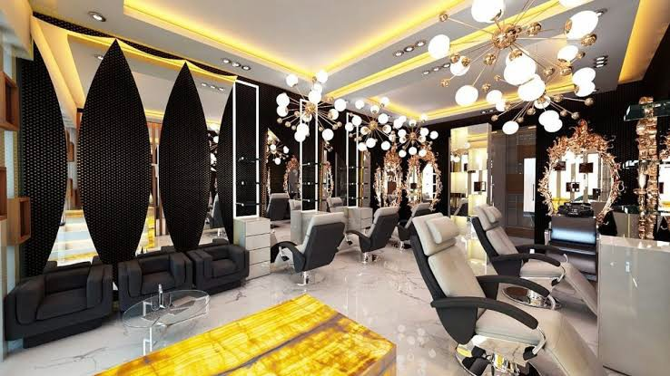
Luxury Services and Bespoke Beauty
DEDICTAED LUXURY LOUNGE
BESPOKE DELIGHTS CAFÉ SERVICES VALLET SERVICES
Since we believe in pampering our client we want to go above and beyond the tradiIonal oﬀerings.
A well lit place with a chic ambience and comfortable siYngs make the
salon a beZer place to spend hours of your busy life.

Slide 7
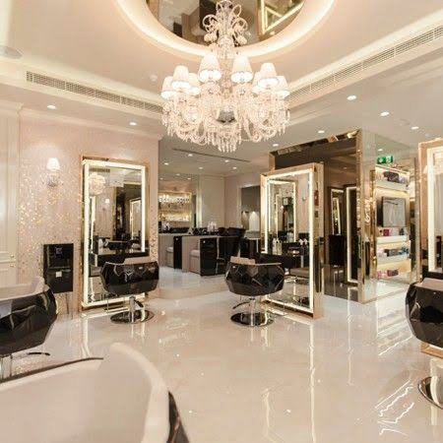
SUPPORT FROM
THE FRANCHISOR
Location Selection
Joint Recruitment & Staff Training
Salon Layout with Turnkey project
Joint Planning for pre-launch & launch activities
Authorised Vendor tie up for Product supply Brand Artwork provision & Inputs in Marketing
Professional Salon Wellness management training to the Franchisee
Salon Software

Slide 8
REVENUE STREAMS
Hair Services
Beauty & Skin Services
Makeup
(Including Bridal services)
Nail services
Treatments & Facials
(Massages & Therapies)
Product selling
(High margins on Product sales) Memberships
SERVICE
CATEGORIES & INCOME
STREAMS

Slide 9
Partner Brands
HAIR - Color- Wella
Care - Nashi
Premium Care - Aveda
BEARD - Beardbury’s
NAILS - BLUE SKY
GLAMM
SKIN – Trials will start
MANI/ PEDI – Trials will start
BRIDAL MAKE UP – will start
What we choose is what we believe. Our result oriented hand picked products are indulgent for our guests to invest and reinvest in our services.
Of menu or bespoke, we intend to rejuvenate and reinvigorate the senses.
SALON SOFTWARE – Salonist
FURNITURE – Marc / Esthetica
CONSUMABLES – Style On

Slide 10
CONFIDENTIAL
Passing on and copying of this confidential document (s), use and communication of its contents is not permitted without prior written
permission. All rights in the event of grant of a patent, utility model or design patent registration.

